Slide 1


ECEN 403
Mobile Device DEMO
Team #25: The Only WGT Team Member: Serene Singh
TA: Jianhan Pan
Sponsor: John Lusher

Slide 2
Mobile Subsystem
Serene Singh
Design
Test
Design a user friendly cross-platform app for AWG
Successfully Test BLE connection stability and packet transfer
Established BLE Connection with MCU
Developed Front-End UI
Preset, Drawable, and Arbitrary adjustable screens with local waveform simulation
Included waveform editing, uploading, and downloading
Verified standard waveform parameters send to MCU accurately
Verified arbitrary waveform packets send to MCU accurately
Stress and Repeatability Testing ensured consistent results

Slide 3
Features
Connect Screen
Editable AW
Standard Waveform
Drawable AW

Slide 4


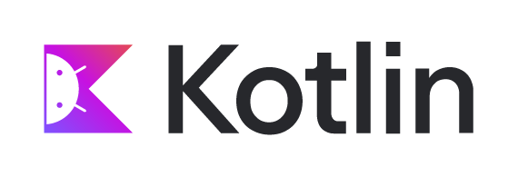
Environment /Code Justification
Android Studio: Kotlin
Android Only
Standard BLE + Classic SPP
Mature Docs, Libraries, and Tools
XCode: Swift
IOS Only
BLE via CoreBLE
Requires an Apple Device to Test
Good Documentation
Flutter: Dart
Cross-Platform Apps
BLE via Plugins Only
Fastest UI Iteration
Documented Libraries (Open-Source)
Notes:
https://www.miquido.com/blog/flutter-vs-kotlin-vs-swift/
ChatGPT

Slide 5
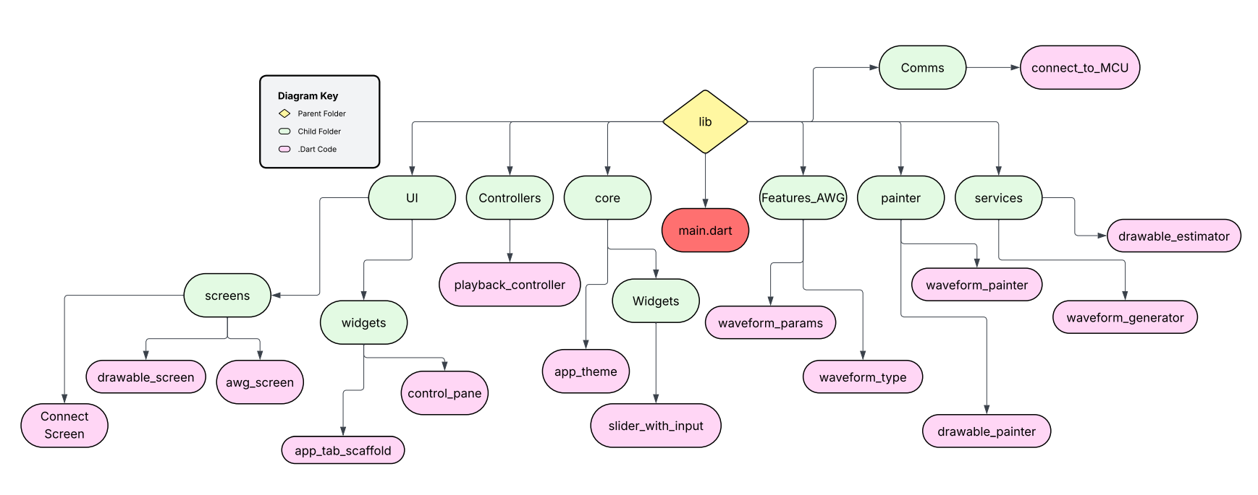
Mobile Device: Code Organization
Green Box: Newly Implemented
Yellow Box: Known Bugs/UI Fixes
Red Slash: Removed Feature

Slide 6
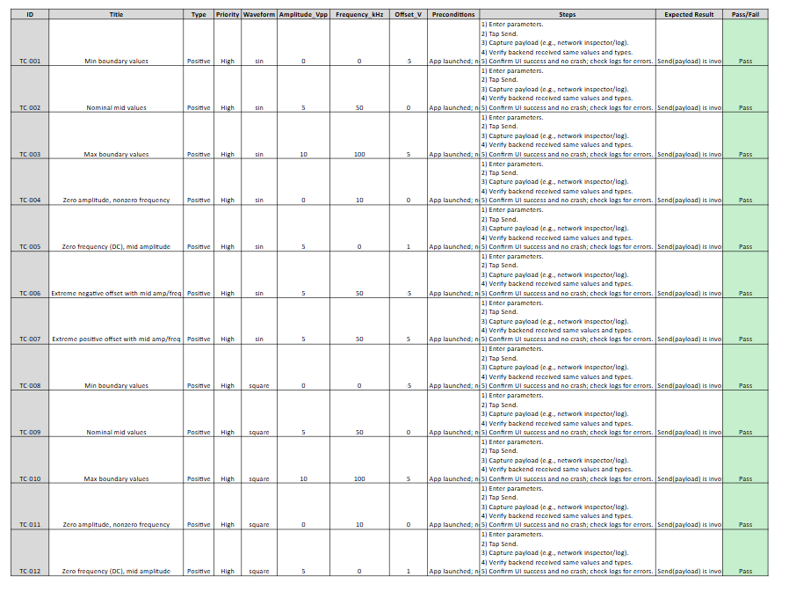
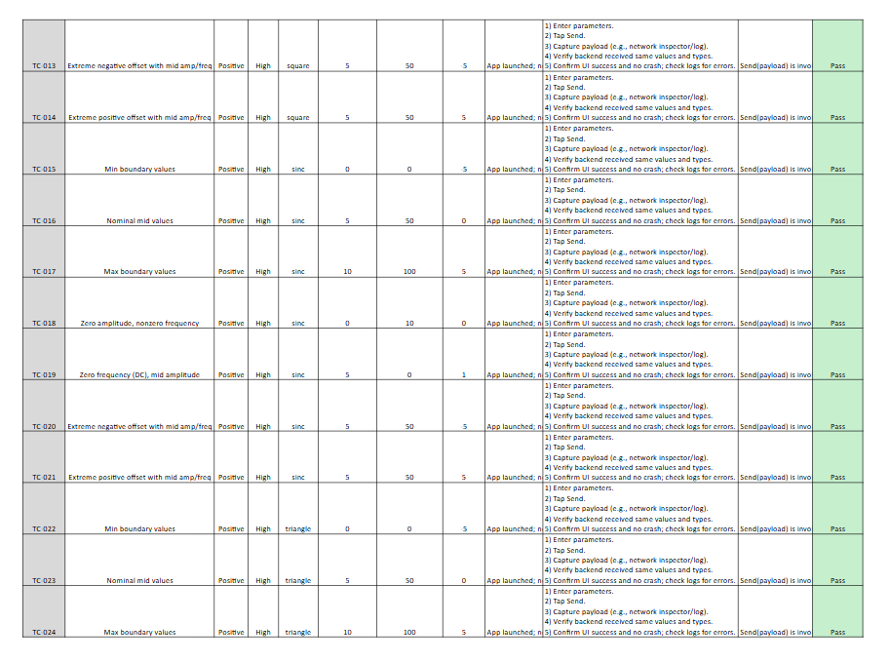
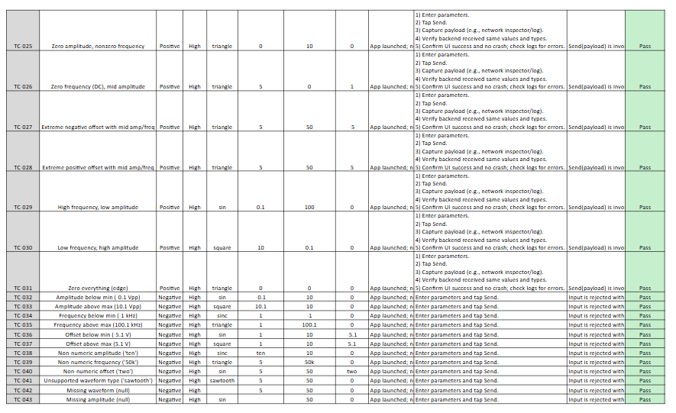
Verified Standard Waveform Parameters
All Tests Passed!

Slide 7
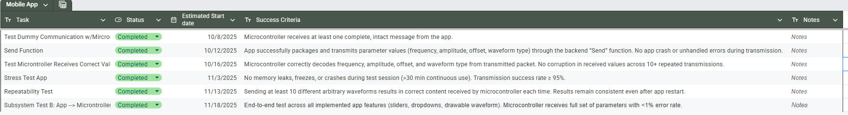
Validation Plan
‹#›

Slide 8
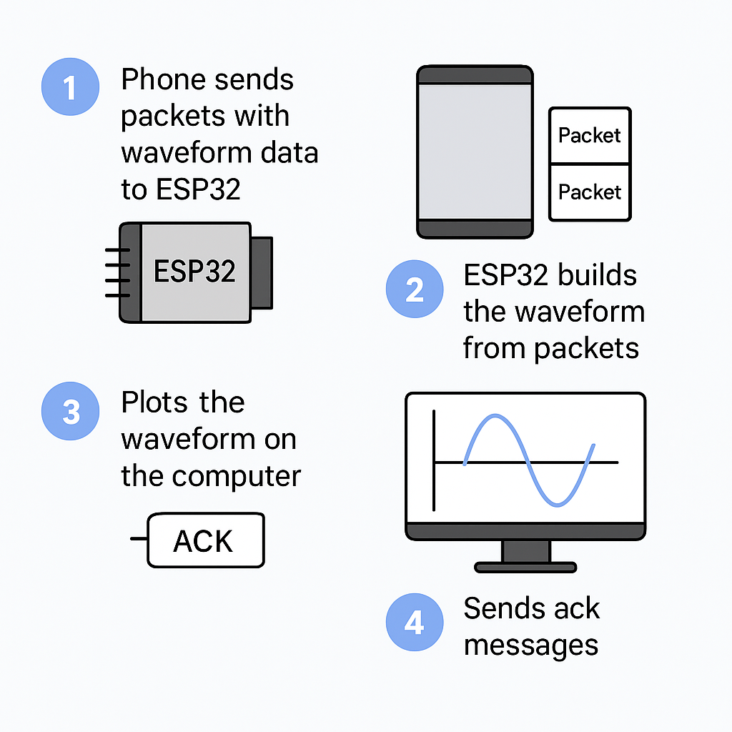
Arduino Code Breakdown
Three message types:
0x00 carries standard waveform parameters
0x01 carries ARB metadata,
0x02 carries ARB sample data blocks.
Fixed 32 bytes: Fixed 32-byte META/standard packets simplify parsing and keep them small enough for reliable BLE transfers.
SRC_FULL meaning: SRC_FULL = 65536 defines a virtual full-resolution index space for the ARB waveform

Slide 9
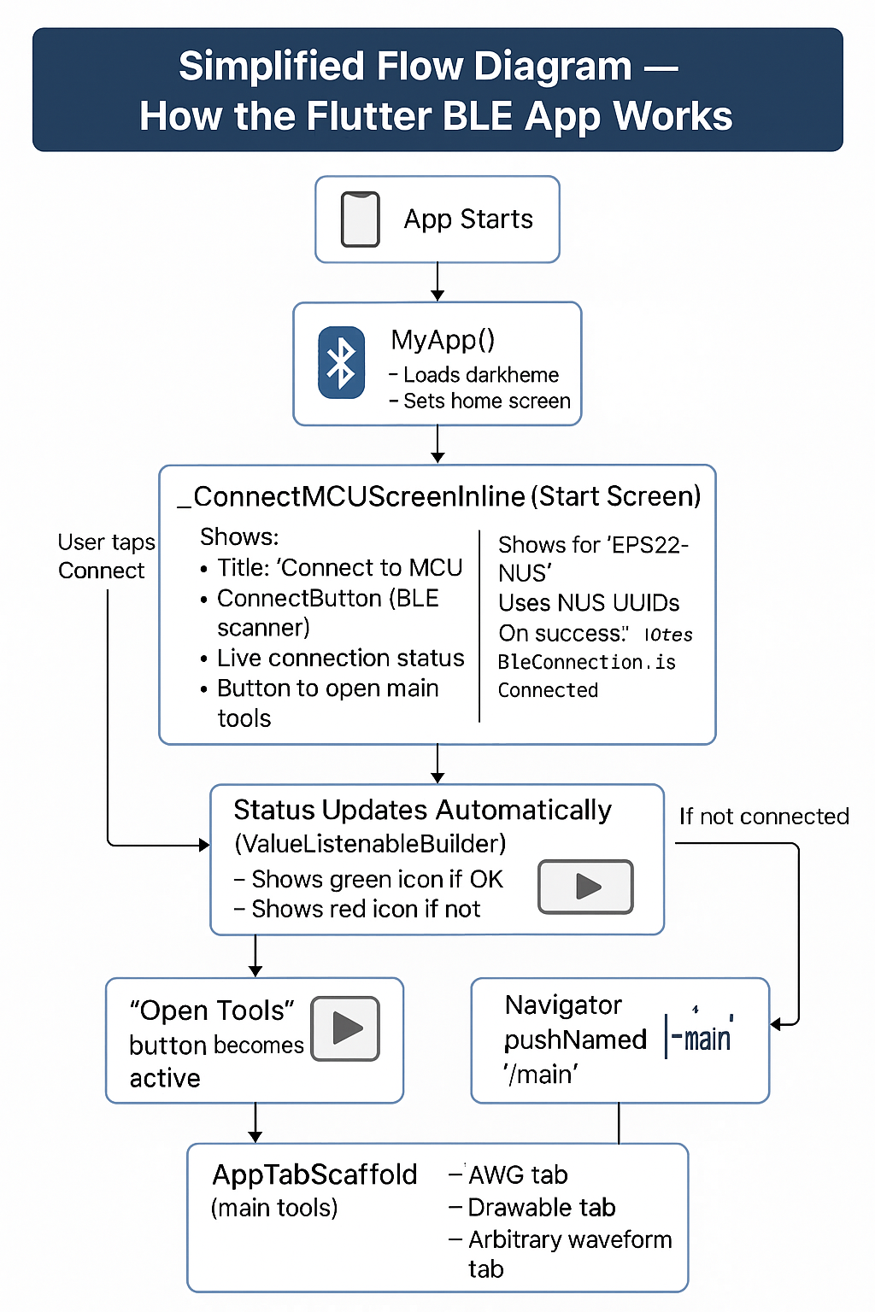
Main.dart Code Breakdown

